Slide 1

Collaborative Faculty
Workspace

Slide 2

Submitted By:
Keshab Kumar (2201330100132)
Tanya Shrivastava (2201330100268)
Avarnita Srivastava (2201330100078)
Dhanya Dwivedi (2201330100307)

Slide 3
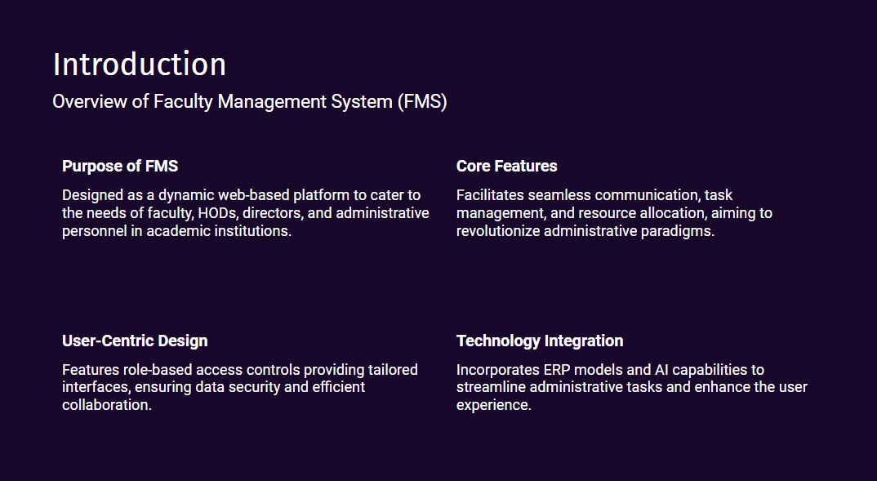

Slide 4
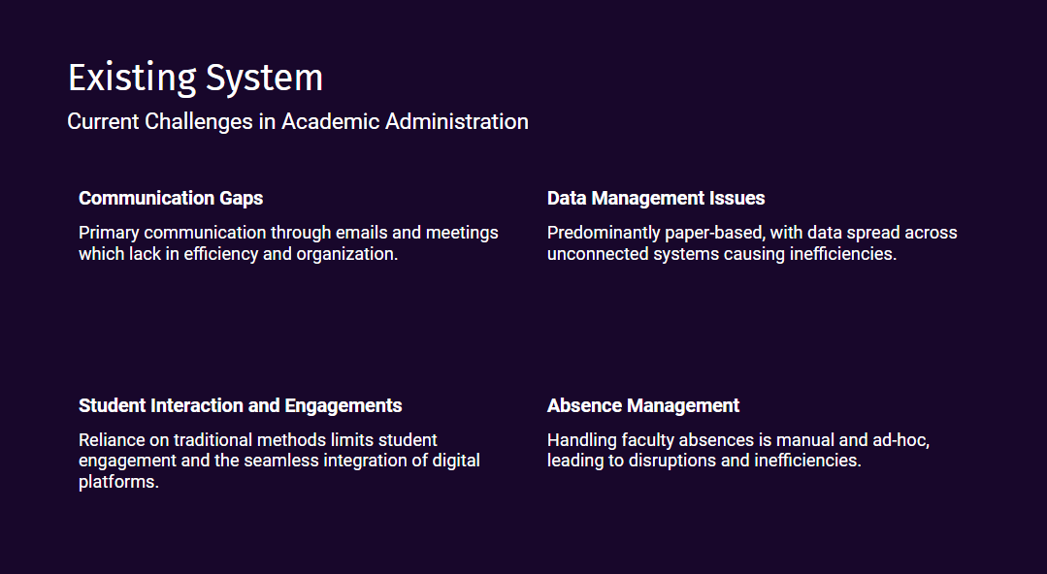

Slide 5
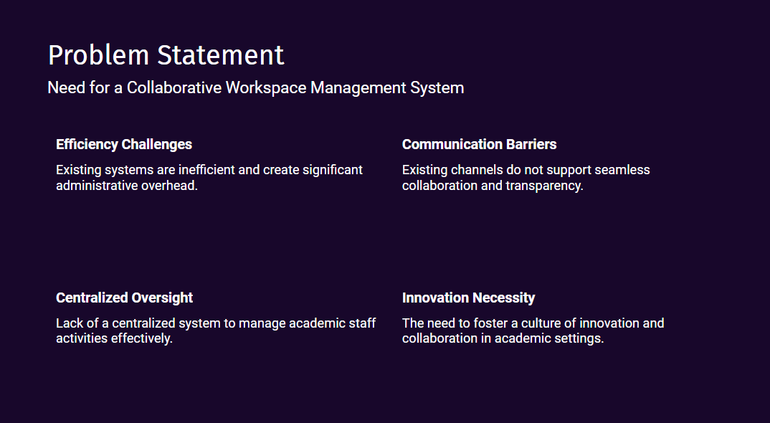

Slide 6
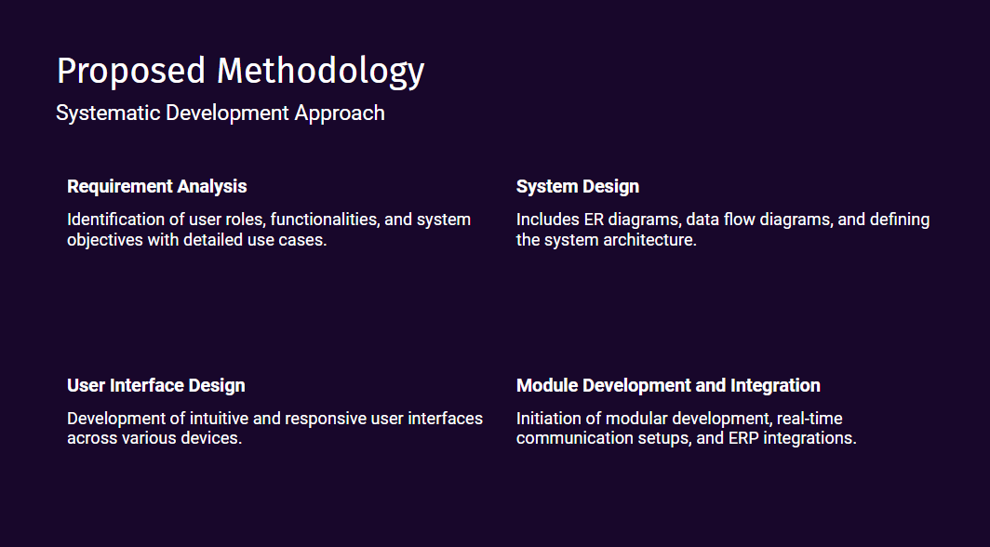

Slide 7
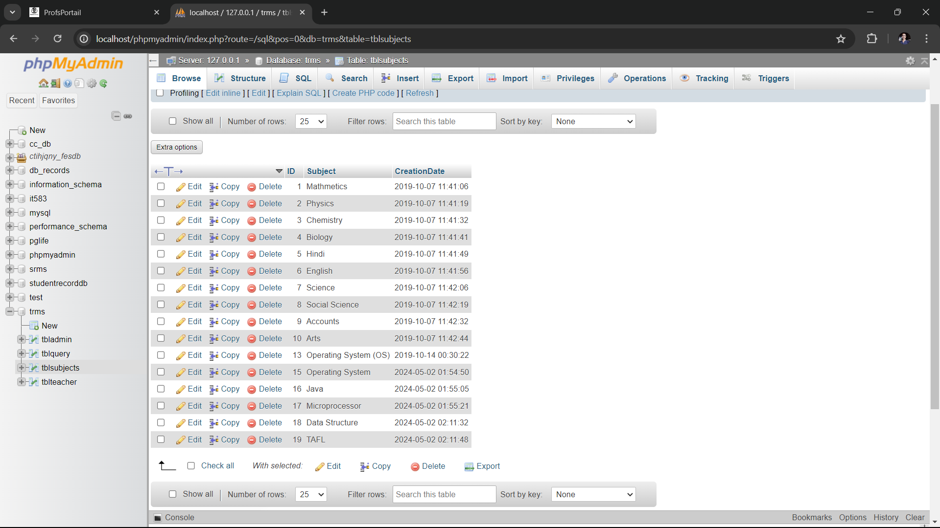
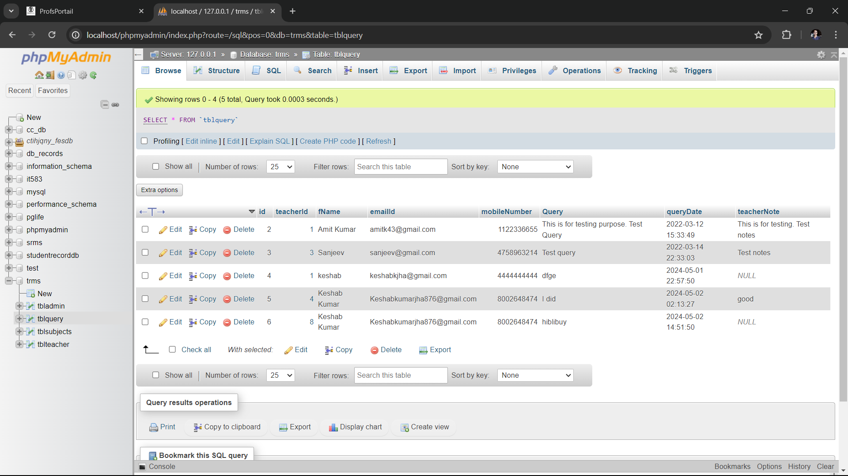


Slide 8
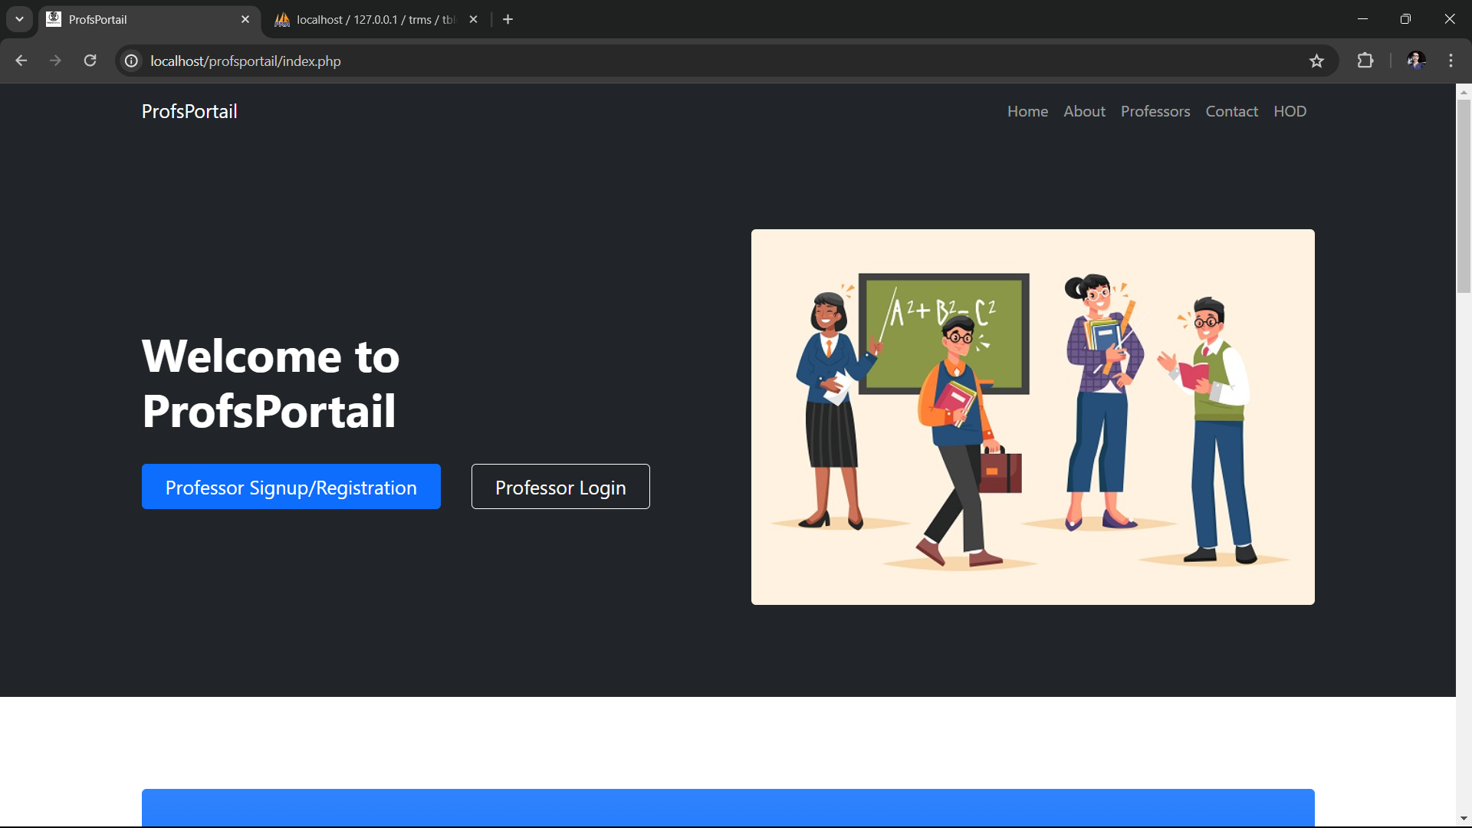

Slide 9
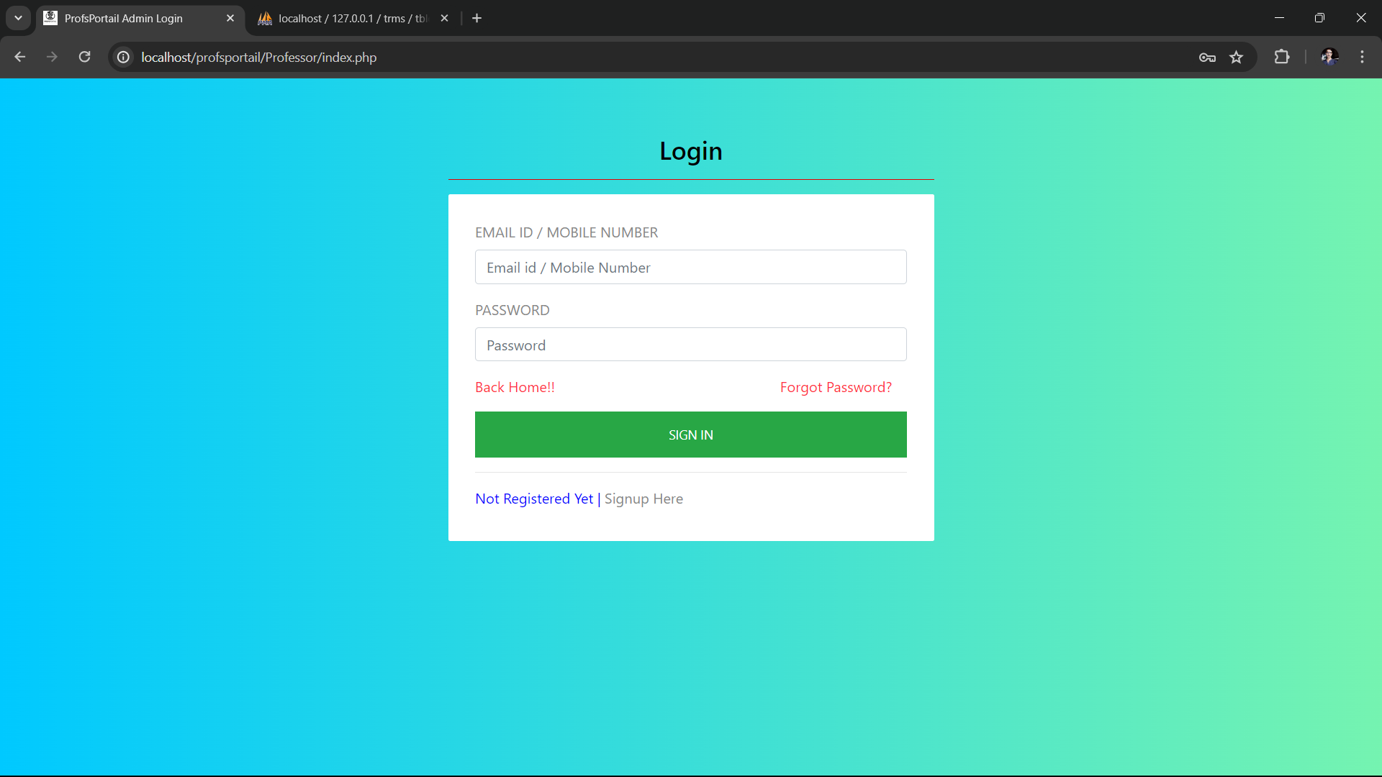
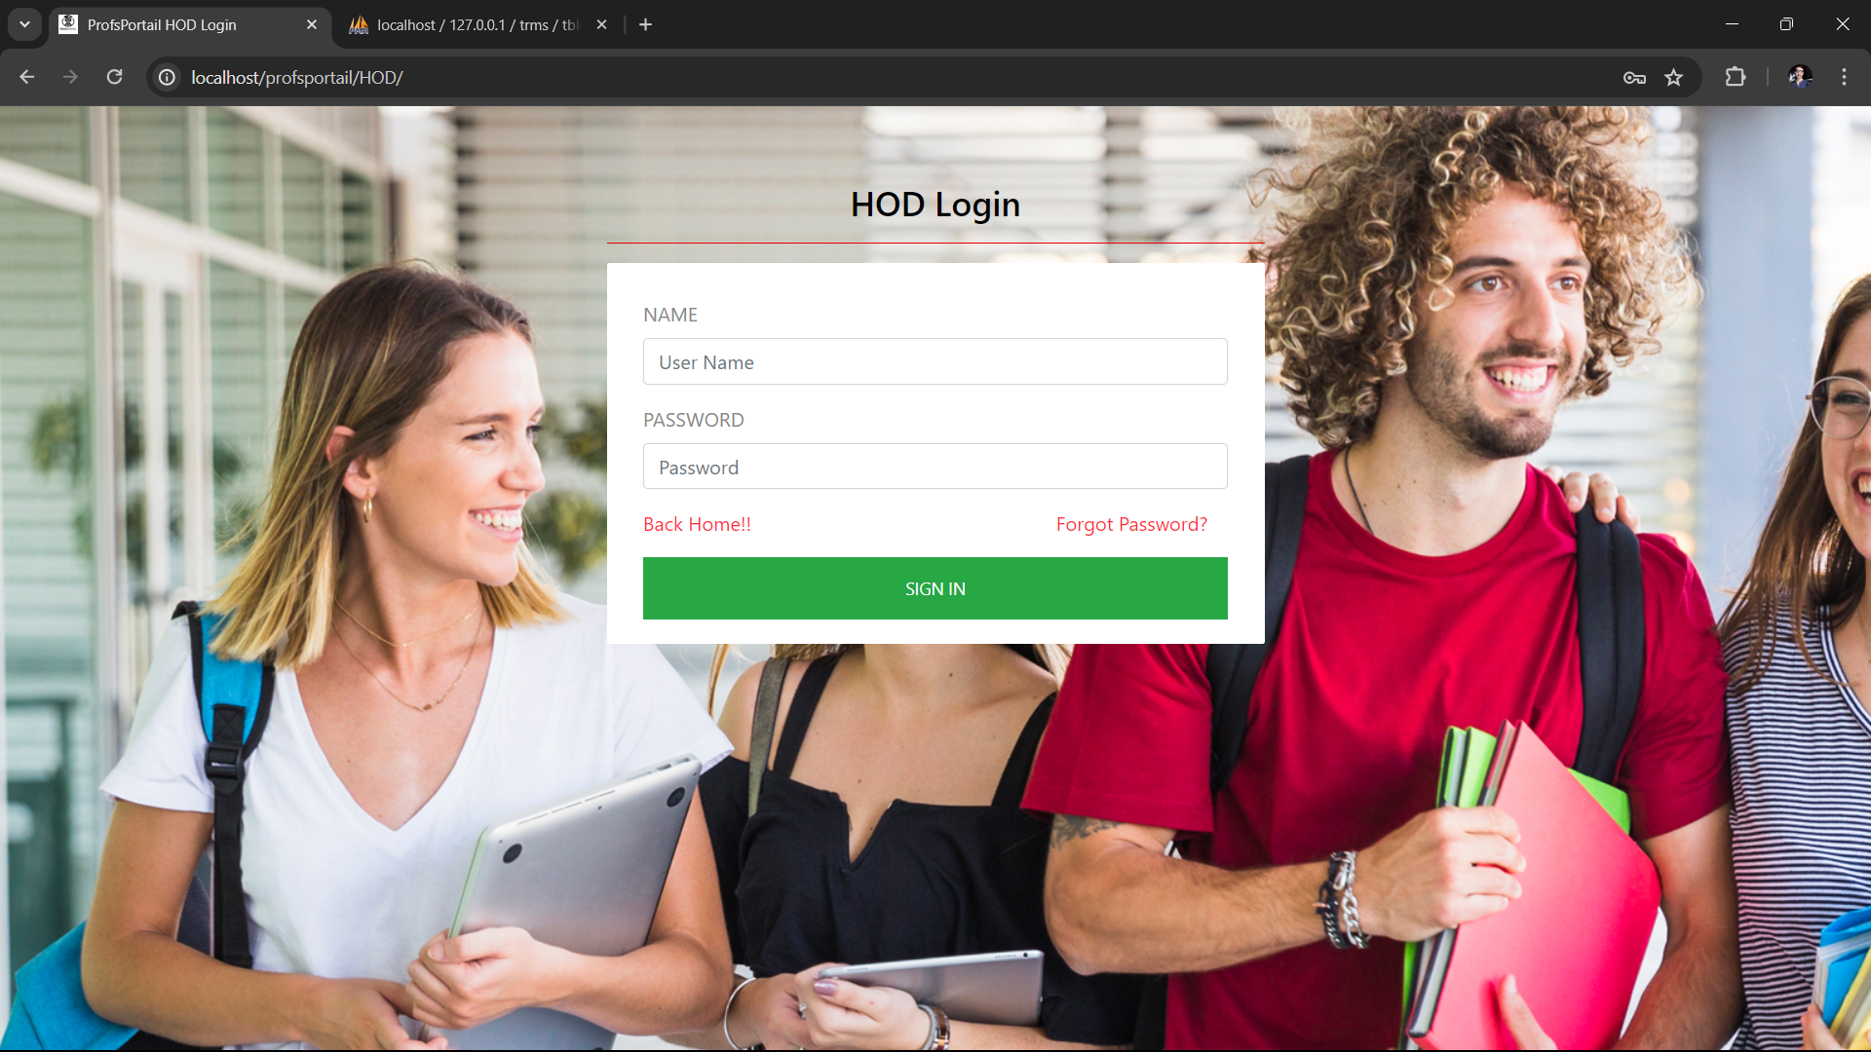
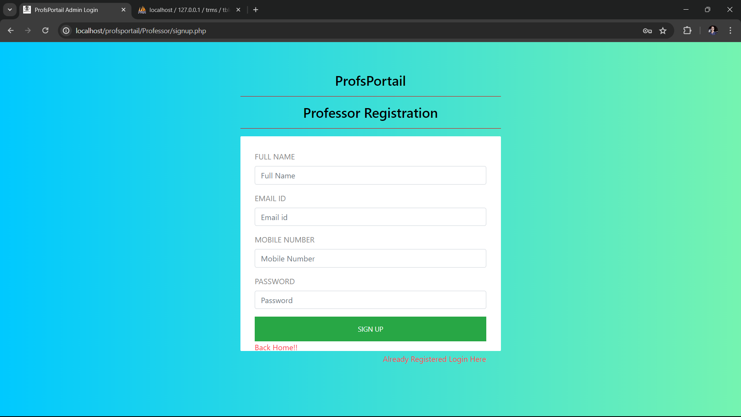

Slide 10
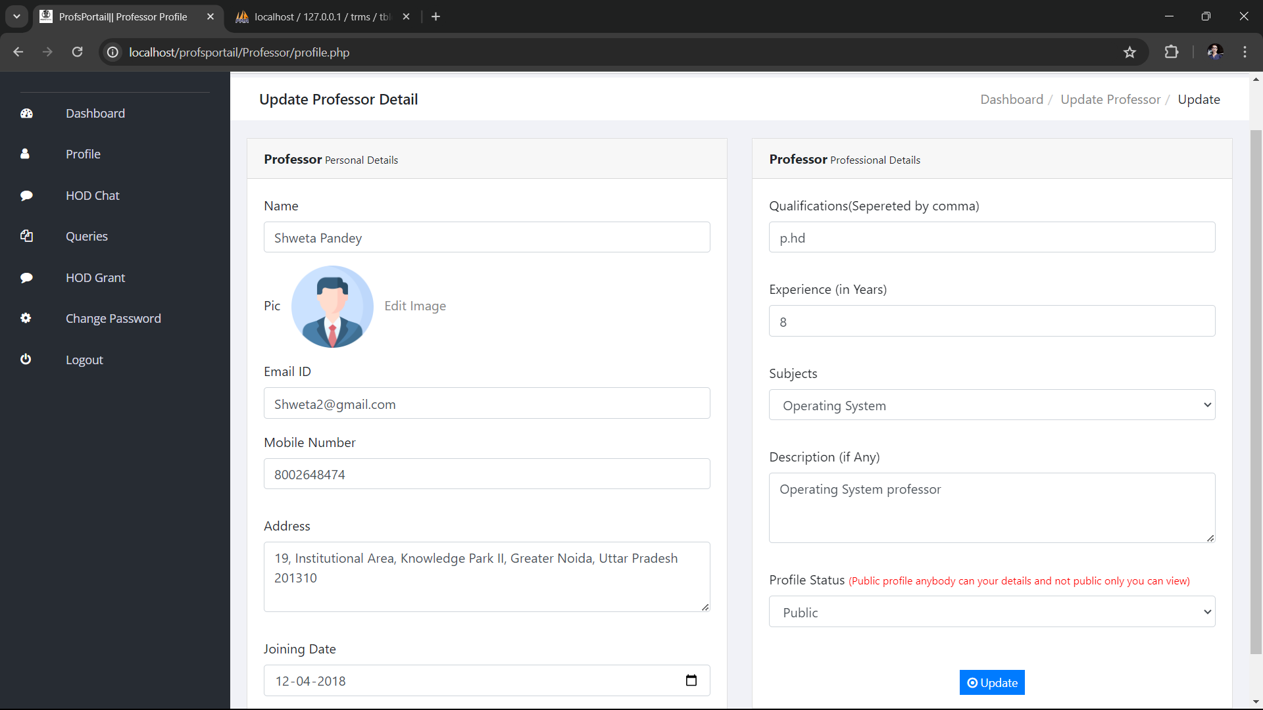

Slide 11
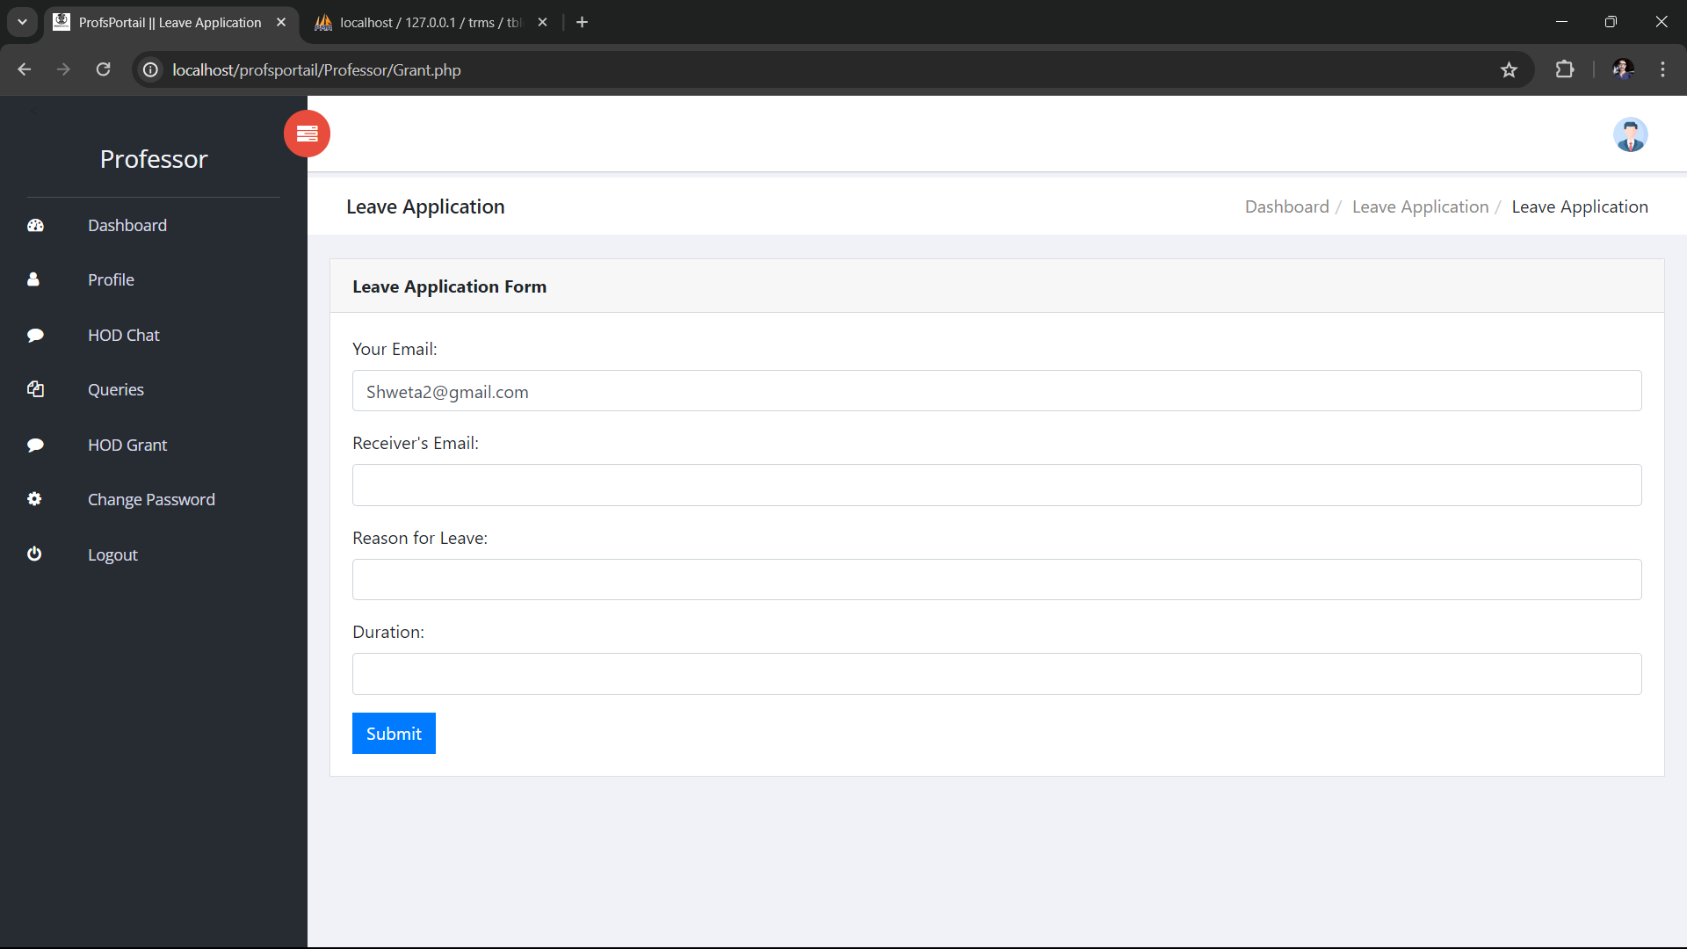

Slide 12
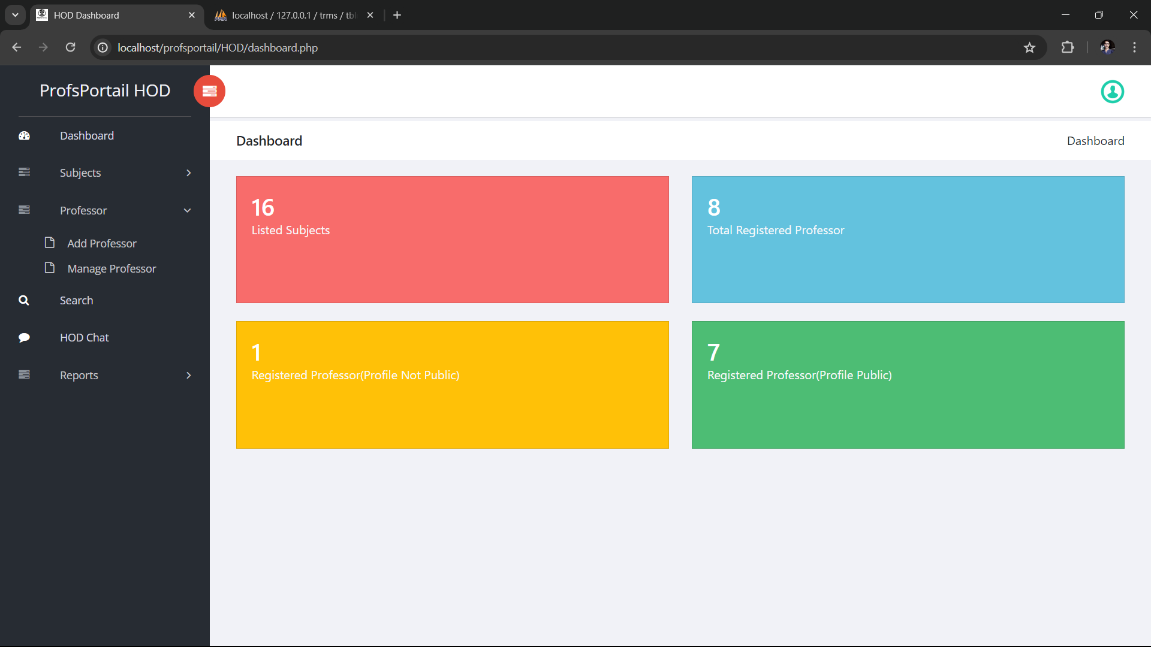

Slide 13
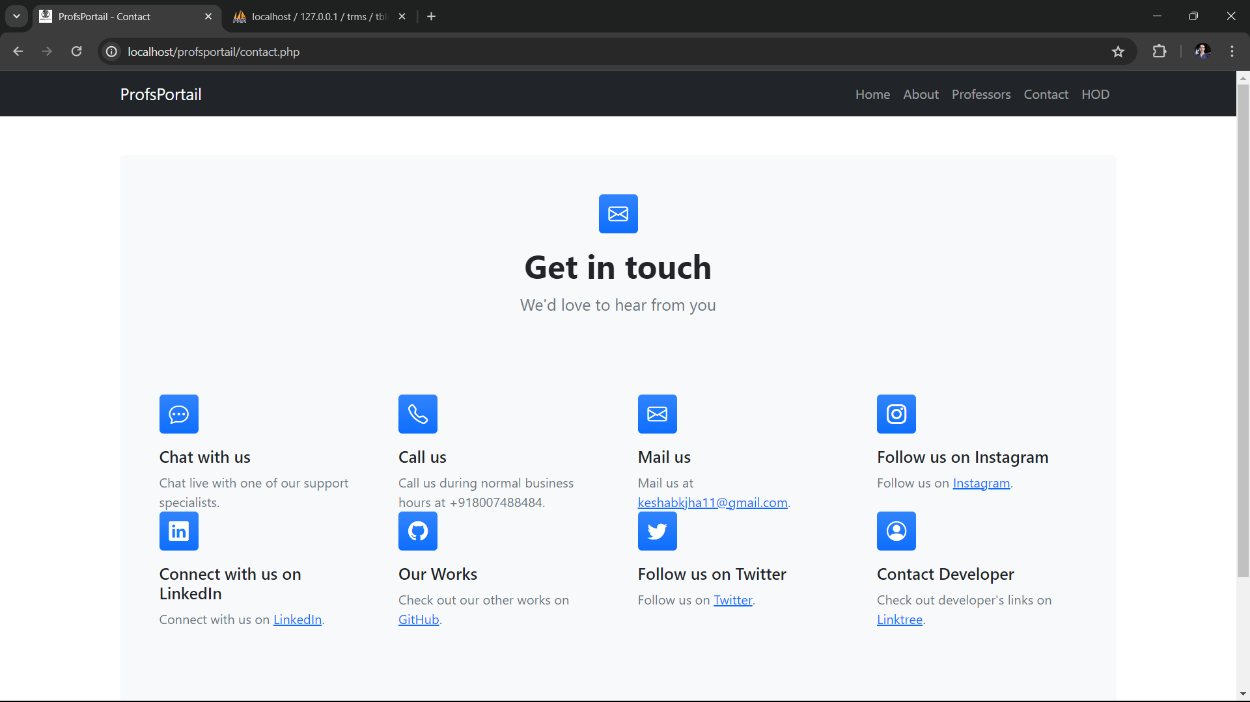

Slide 14
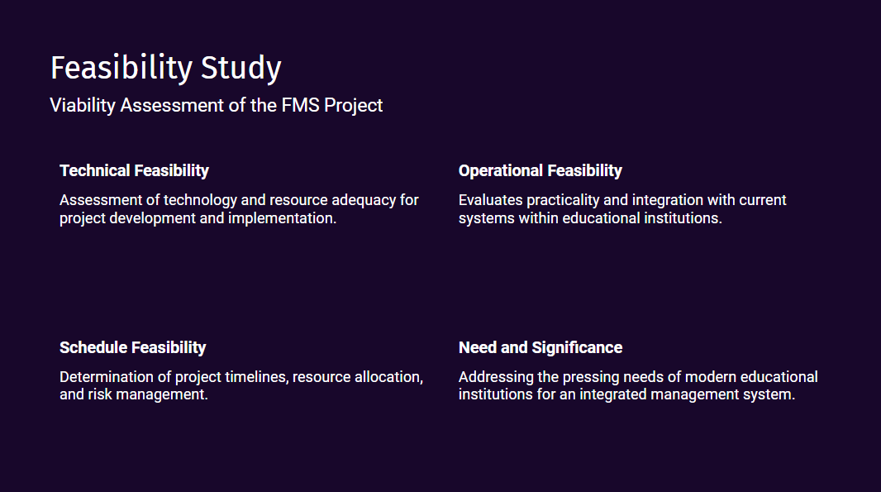

Slide 15
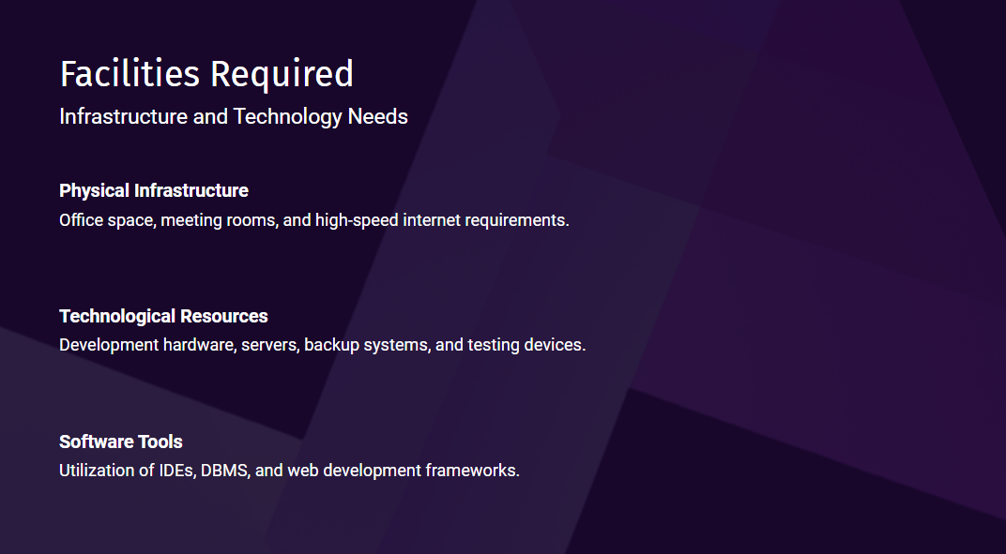

Slide 16


Slide 17
References:
https://www.w3schools.com/php/
https://chat.openai.com/
https://ucop.edu/building-administrative-services/services/facility-services/workspace-management.html
https://www.scholastic.com/teachers/teaching-tools/articles/resources/teacher-workspace.html
https://openai.com/blog/openaiapi
https://www.geeksforgeeks.org/javascript/
https://www.ieee.org/publications/index.html

